Slide 1
DATA CLEANING
Entrepreneurial Competency in University Students
Alix ,Chahra and Mario

Slide 2
Content
1- Cleaning the Data
2- Exporting the Data into CSV File
3- Conducting a query on mysql
4- Some Insight
5- Challenges

Slide 3
Macro/ Micro Cleaning

Slide 4
Macro Level
1- Look at the raw file for preliminary insight
2- Fix structural errors:
a-to_lower_letter=[‘TargetIndividualProject','Gender','City','Influenced','MentalDisorder','ReasonsForLack','ReasonsForLack']
for i in to_lower_letter:
data[i]=data[i].str.lower()
b-
data.rename(columns={'Target-ent_competency':'TargetEntCompetency'}, inplace=True)

Slide 5
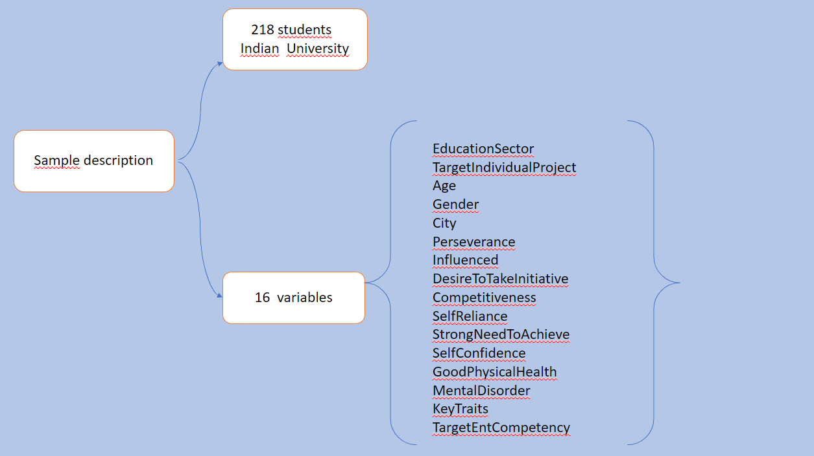

Slide 6
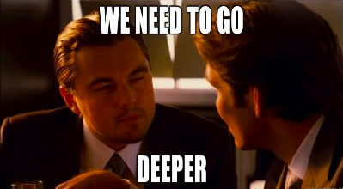
Micro Level Cleaning

Slide 7

Look for Outlier

Slide 8
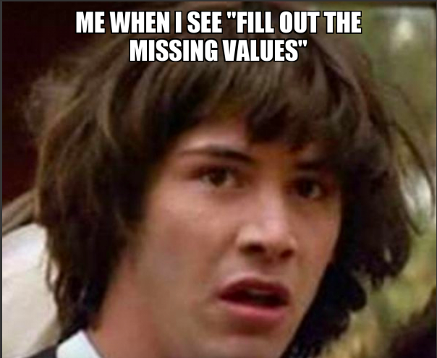
Deal with missing Data
data.loc[data['ReasonsForLack'].isna()==True,'ReasonsForLack']='no reason given’
data.loc[data[‘MentalDisorder'].isna()==True,'MentalDisorder']='undisclosed
data.loc[data['Age'].isna()==True,'Age']=round(data['Age'].mean())
data['Age'].mean()

Slide 9
#putting mean age to fill the empty age data
data.loc[data[‘Age'].isna()==True,'Age']=round(data['Age'].mean()) data[‘Age’].mean()
#dropping unnecessary columns data.drop(columns="ReasonsForLack", inplace=True)

Slide 10
Uploading data Into the computer
data.to_csv(r'/Users/naitsaidifariza/Desktop/data_cleaned.csv')

Slide 11


Slide 12
Get Dummies Encoder
- pd.get_dummies(data[“Gender”])
-pd.get_dummies(data[“EducationSector"])
-

